Slide 1
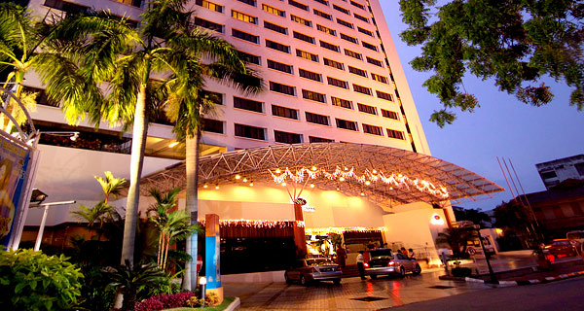
Hotel Data Base Application
Team Members:
Lovell Felix, Jignesh Desai, jon krueger, Nicholas Zillweger

Slide 2
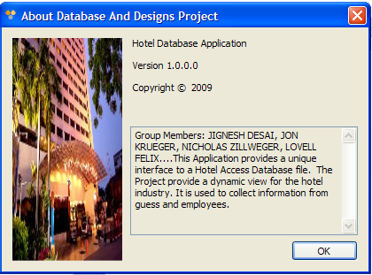
Introduction…
This project is a desktop database application. The design of the database application allows employees of a hotel to capture information from its operations, and convert them into meaningful data.
The data collected by the application will assist management to improve the hotel operation, and in turn, maximizing it’s profitability.
The features of the application include a user friendly form interface and simply one click reports creations.

Slide 3
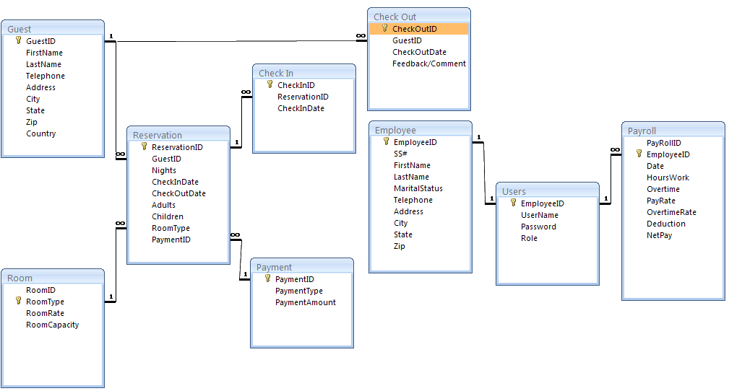
Entity - Relationship Diagram

Slide 4
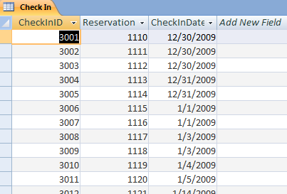
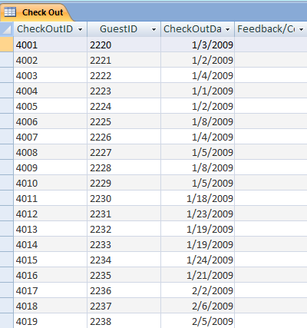
Tables within the Database…
Check-in & Check-out Table
These are the base operations of any working hotel. It’s the main foundation for answering the reason a database is created for a hotel. The main point of a hotel is to incorporate their guests into rooms and they must reserve a date for the hotel of their choice. Within a database, our tables include the name of the person and the date that they will be arriving which is the most crucial information in the reservation.
Guest Table
Our customer table is all the relevant information pertaining to the person who is reserving the room. Where they are coming from and who they are is mandatory information to make sure that if the customer has a problem we can make sure that we have credible information to reach them and correct a mistake.

Slide 5
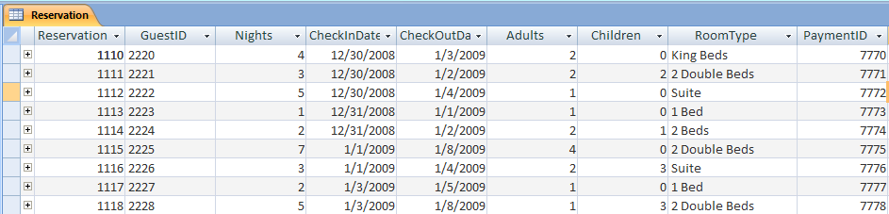
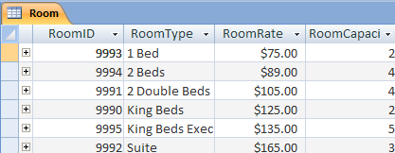
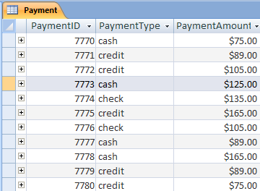
Tables within the Database Cont…
Reservation Table
The Reservation table stores information about when a room is assigned to a guess and for how long it assigned for. This is basically our inventory. All of our rooms that are taken by a customer will be documented in this table. We have duration of stay and which type of room is taken as well.
Room Table
In a hotel, there are several different types of rooms that can be occupied. This is the table that showcases our rooms, how much money each room will cost, and the recommended capacity.
Payment Table
Each customer will be tied to the payment table. This table is where we store all the financial information we need on the guest. We included how they will be paying for there room and the final price for their rooms as well.

Slide 6
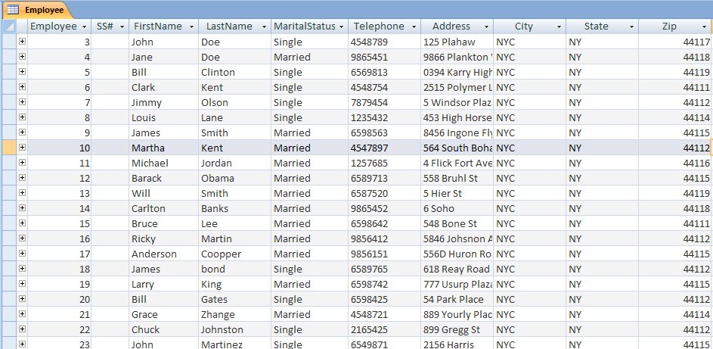
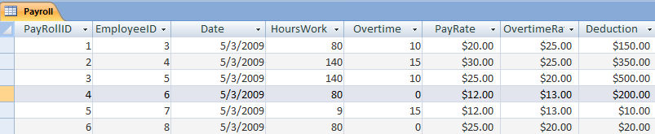
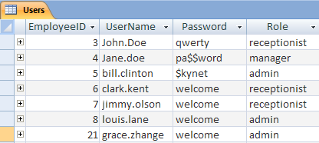
Tables within the Database Cont…
Employee Table
This is our table to provide the inner workings of the hotel. This table shows the employees we have working to keep the stability of the hotel up. We basically just keep the personal information of our employees here.
Payroll Table
The inclusion of payroll is to provide our employees with a realistic salary to compensate for their specific roles in the corporate ladder. We have pay deductions and hourly rate provided to enhance how realistic our company runs.
Users Table
Finally we have our users table. This table shows the members that have access to our database. Not much information is shown here about those individuals, that information you can see in the employee table, but their name, password, and job.

Slide 7
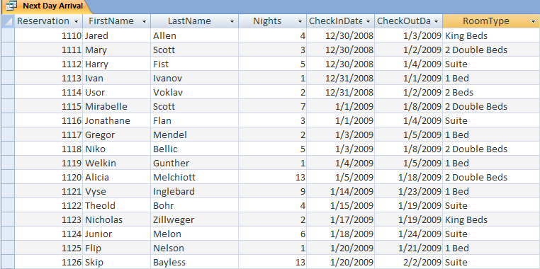
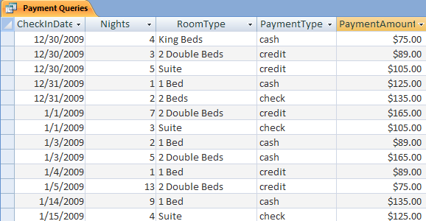
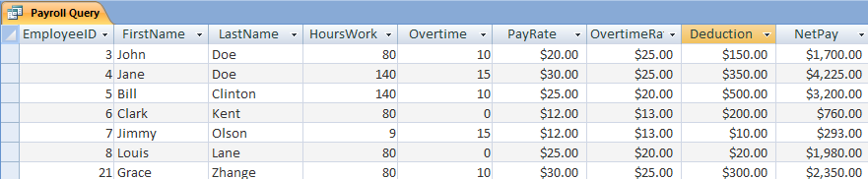
Queries and reports…
Types of queries in The Hotel database
Next Day Arrival
Shows customer information and their expected date of arrival to the hotel.
Forecasts the coming week of expected business.
Keeps track of room inventory and guest information.
Can generate an employee work schedule.
Payment
Shows data that is necessary to keep track of sales and the type of rooms rented.
Can see the preferences of payment compared to how much is being spent in the hotel.
Can see the amount of money generated from the types of rooms offered.
From all of this information the hotel can raise or lower rates due to this query.
Payroll
Shows employee information and wages given.
Basic calculations are used to display Net Pay and Total Pay.

Slide 8
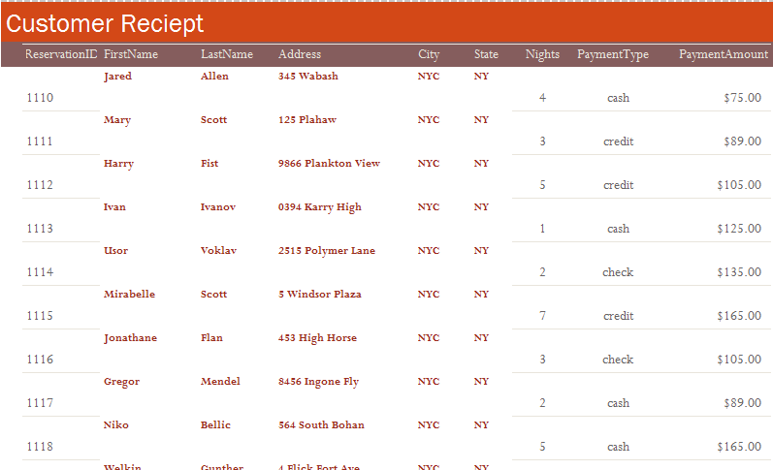
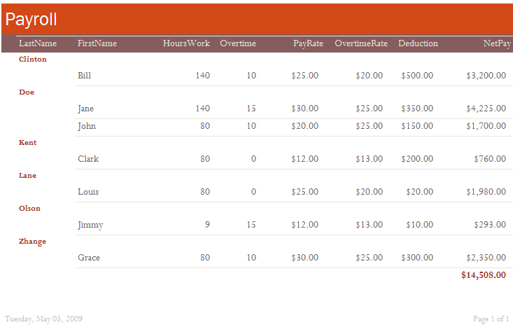
Queries and reports Cont…
Two types of reports were created a Customer Receipt and a Payroll Report to keep track of hotel spending and hotel income.
Customer Receipt
Displays customer information and the amount owed/received.
Useful for the hotel for records use.
Can help in forecasting business.
Payroll
Ongoing updates to payroll.
Keeps an eye on hotel spending and employees.
Helpful for employee evaluations.
Payment

Slide 9
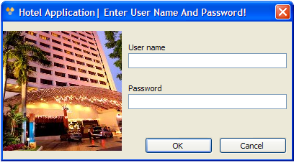
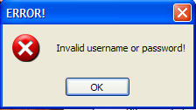
Security: Authenticating Users
Login credential was authenticated by a SQL script [SELECT Role FROM Users WHERE UserName = '" & txtu.Text & "' AND Password = '" & txtp.Text & "'“]
Selects from the ROLE COLUMN in the USERS TABLE where the username entered in the username textbox ‘txtu’ is equal to username in the users table and the password USERS TABLE is equal to text entered in the password textbox ‘txtp’
An “IF” statement was used in the VB Code to show the error message
IF (sdr.Read() = False) THEN
MessageBox.Show("Invalid username or password!", "ERROR!", MessageBoxButtons.OK, MessageBoxIcon.Error)

Slide 10
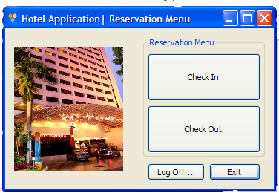
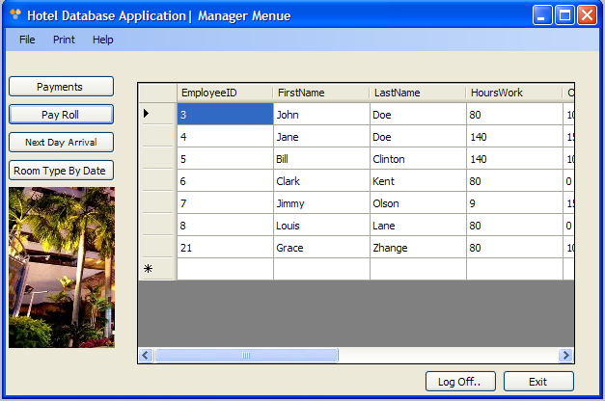
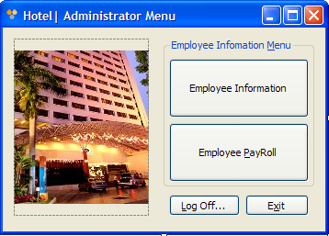
Security: Restricting User Access…
USER ROLES | DESCRIPTION OF ACCESS | TABLE ACCESS
Receptionist | Add New, Delete, Edit Reservation Data and Print | Guest, Check In, Reservation and Check Out
Manager | Generate and Print Reports | Manager Form/Report Menu
Admin | Add New, Delete, Edit Employee Data | Employee, Users, and Payroll

Slide 11
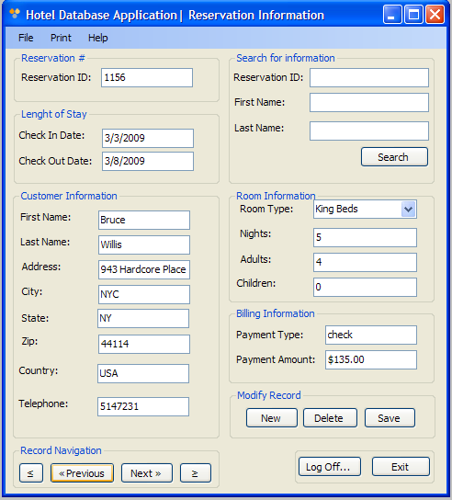
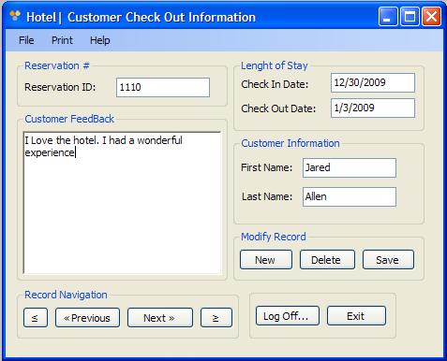
Forms: Receptionist User Interface…
Check In Form
Check Out Form

Slide 12
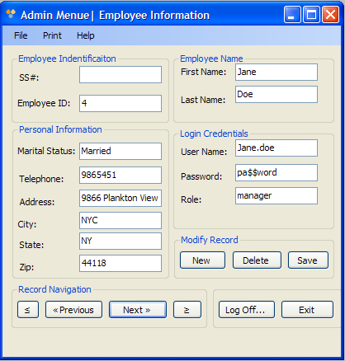
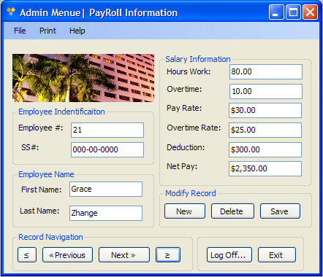
Forms: Administrator User Interface…
Employee Form
Pay Roll Form

Slide 13
Forms: Manager User Interface…
Report Form

Slide 14
Installing Hotel database Application
End of Slide Show Presentation

